Slide 1
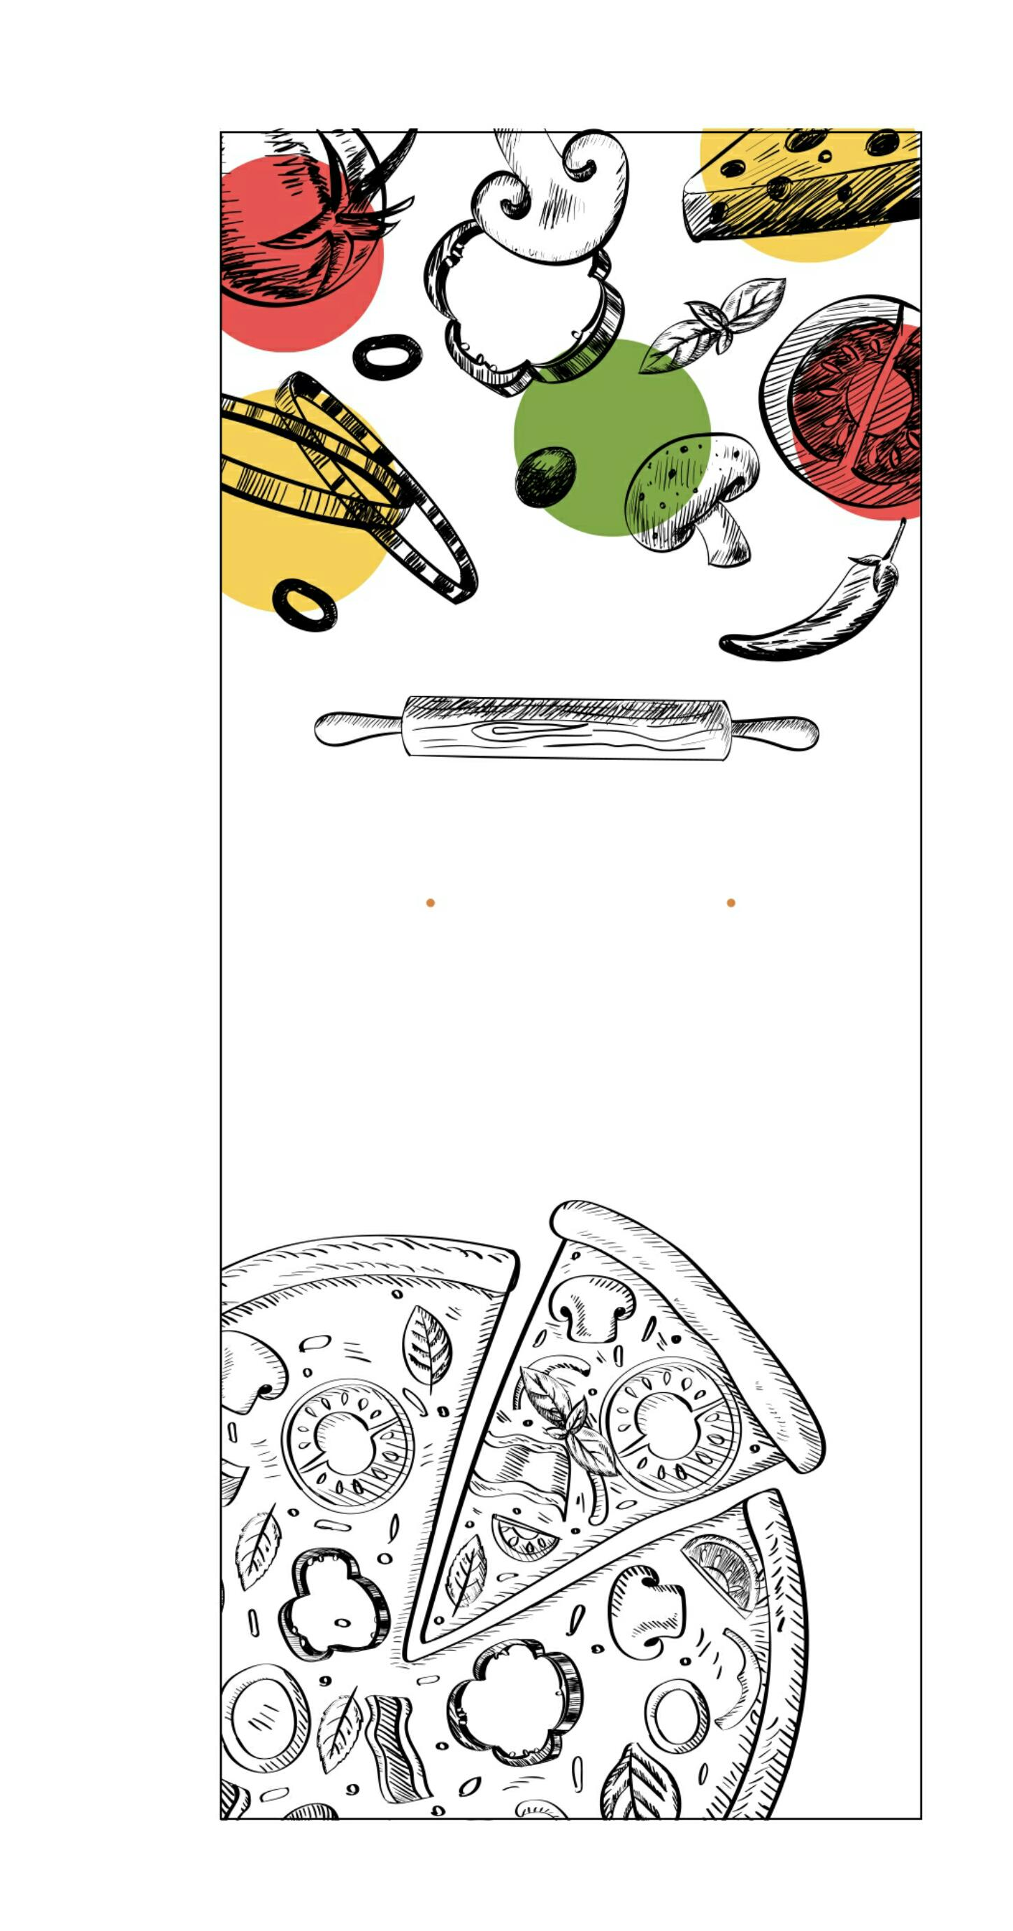
ONLINE PIZZA SHOP
FIRST REVIEW
BY GROUP NUMBER : 3
GUIDE: Ms. Rajalakshmi K R
Ananthu Suresh Eldho M.S Blessin Mathew Abijith Anil Abhijith P.R

Slide 2
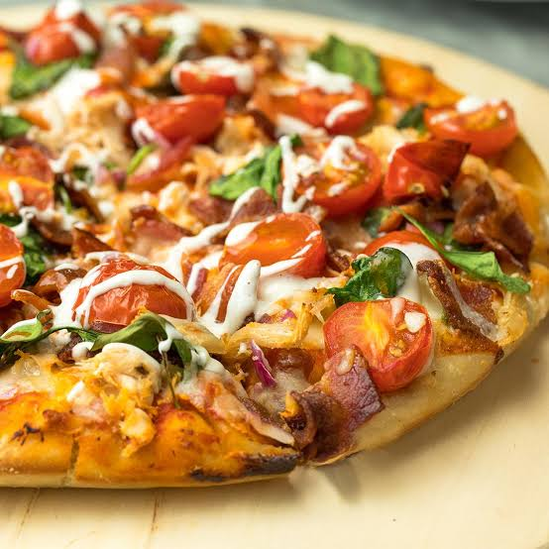
INTRODUCTION
We are dealing with the project on online pizza shop. The central concept of this application is to allow the customers to shop virtually through internet.

Slide 3
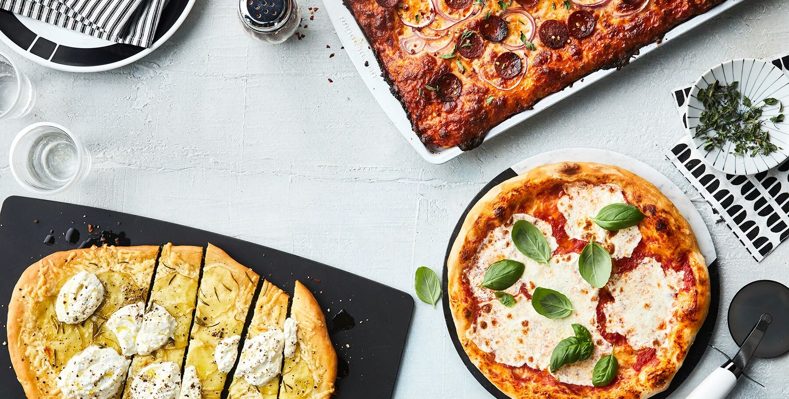
SYSTEM ANALYSIS
System analysis is conducted for the purpose of studying a system or its parts in order to identify its objectives.Finds the cons of existing system and make an proposed system

Slide 4
EXISTING SYSTEM
Existing system is the physical shop and Their works are done manually.Also customers need to visit shop directly.thus it has some problems

Slide 5

DISADVANTAGES OF EXISTING SYSTEM
Time consuming
Less user friendly
Description of product limited
Difficult to identity required product
More manpower required

Slide 6
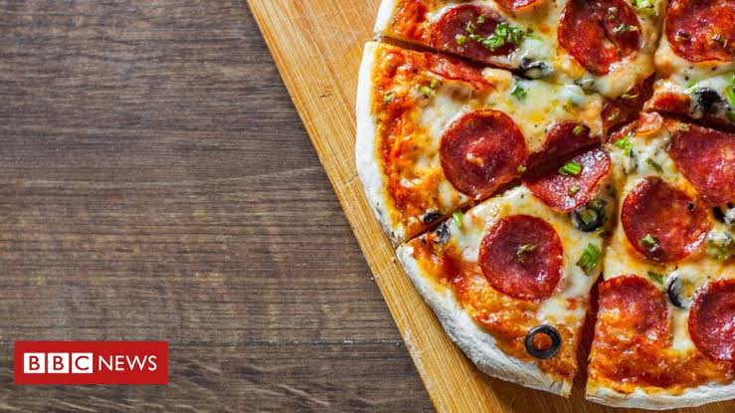
PROPOSED SYSTEM
The drawbacks of the existing system can be solved by new system.that is online pizza delivery
User friendly
Save time

Slide 7
ADVANTAGES OF PROPOSED SYSTEM
Reliable
Fast
Better Service
User friendly
Greater efficiency
Ease of use

Slide 8
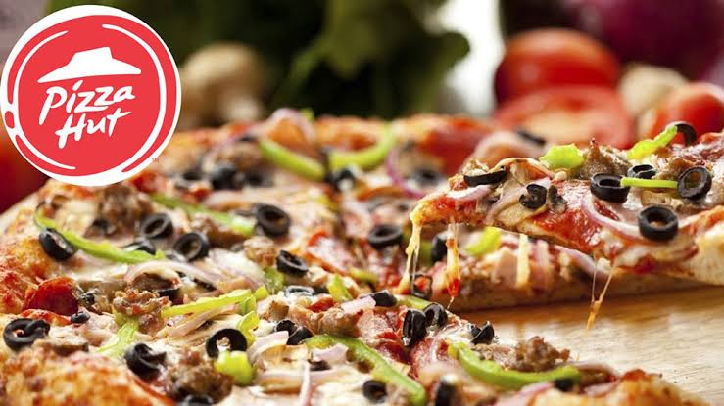
MODULES
ADMINISTRATION
USER MANAGEMENT

Slide 9
ADMINISTRATION
SUBMODULES:
Product Management
Delivery Management

Slide 10
USER MANAGEMENT
SUBMODULES:
Order Management
Feedback

Slide 11
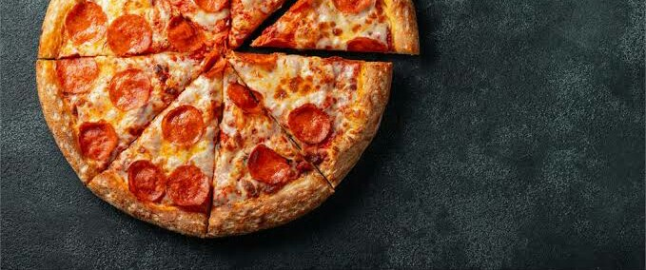
FEASIBILITY STUDY
A feasibility study is an analysis that takes all of a project's relevant factors.
There are 3 types of feasibility studies :
Economic feasibility
Technical feasibility
Social feasibility

Slide 12
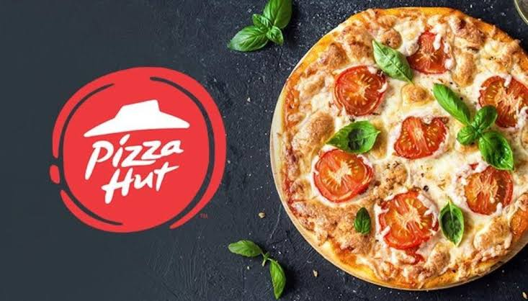
Economic feasibility
• Cost is found to be lesser compared to existing system
• staff training cost is decreased
• Workload can be decreased.
Technical feasibility
The proposed system can be expanded based on the user requirements.
The new system can handle large volume of data

Slide 13
Social feasibility
The proposed system is designed in such a way that even a person who has less computer knowledge can interact with the system freely

Slide 14
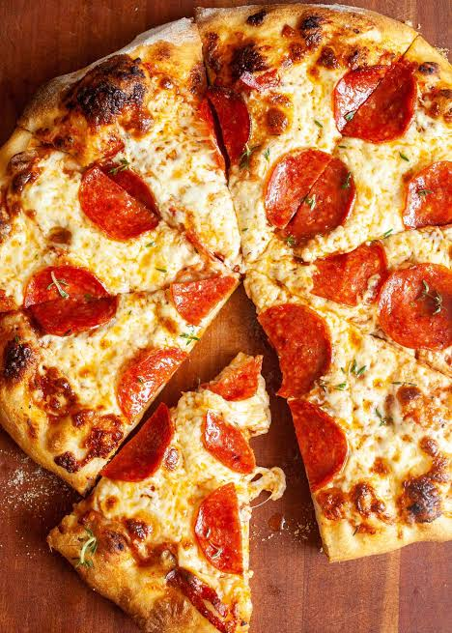
CONCLUSION
The application for online pizza shop is easily accessible, informative and helpful .The application is user-friendly and very simple there by a common man can easily access it .This system allows customers to order pizza of their own choice. It is also upgradable in future

Slide 15
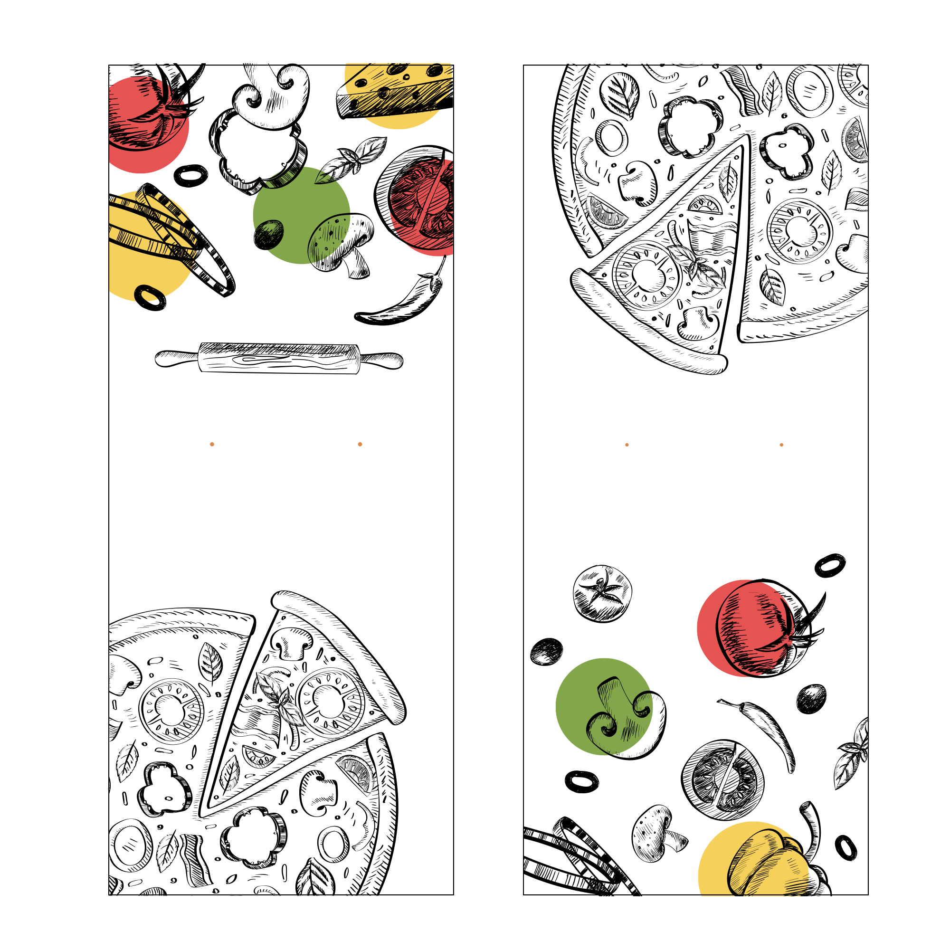
THANK YOU
GRAP YOUR PIZZA NOW

